Slide 1
Identity Scenarios Proof Of Concept
Architecture and Principles

Slide 2

Student logs in
Current
Scenario
Azure AD
Student Portal
Authenticates
To Oracle Identity Manager
➊
❷
Azure AD
App Registration
Student
Authentication
Token
(OAuth Bearer/ JWT)
WebFred

Slide 3
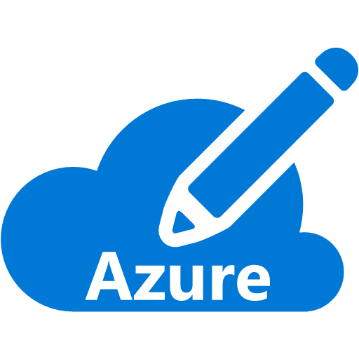


Process flow
Proposed
POC -1
STEP | EVENT
0 | Blank Azure Subscription
Azure AD
1 | User Credentials for authentication passed to AAD App Registration
Webfred Portal
2 | AAD App registration validates and return security Token. Web application sets cookie to maintain session with user.
Login
1
2
Student
Azure AD
App Registration

Slide 4
Process flow
Proposed
POC -2
STEP | EVENT
0 | Blank Azure Subscription
Azure AD
1 | User Credentials for authentication passed to AAD App Registration 1
Student Portal
1
Login
2
2 | AAD App registration 1 validates and return User Token
3
6
Student
Azure AD
App Registration 1
3 | Student Portal request Access token from AD app reg 1 for Webfred portal
5
4 | Request AAD app reg 1 requests Access token from AAD app reg 2
4
5 | AAD app reg 2 returns Access Token
WebFred Portal
6 | Access token is send back to student portal to redirect to WebFred Portal
Azure AD
App Registration 2

Slide 5
On-Premises NBME employee logs in
Current
Scenario
Azure AD and On-premises AD Domain controller are connected using Azure AD Connect ( refer details here Trust diagram)
➊
WebFred / any other NBME Application
❷
➎
NBME
Employee
➌
➍
Azure AD
Windows Server
Active Directory
NBME On-Premise AD

Slide 6
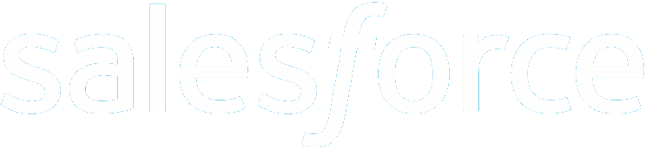
Student Logs in to SalesForce
Future
Scenario

AAD Application Authentication
Uses AAD Registered Application, Client ID and Secret
Microsoft Azure Active Directory
Student
Authorization
Token
(OAuth Bearer/ JWT)
WebFred / any other NBME Application

Slide 7
Authentication across Architecture Layers
Future
Scenario
WebFred / any other NBME Application
Front End
Authorizes based on Authorization Token and lets the request continue
User
AAD Application Authentication [Uses AAD Registered Application, Client ID and Secret]
[Optionally]
Sends Authorization Token for Middle Tier (registered as an AAD Integrated Application)
Microsoft Azure Active Directory
Middle Tier (Business Layer)
Looks up datastore connection string in secure store
(like Azure KeyVault)
Data store
Authorizes based on Authentication Token and lets the request continue

Slide 8
Application to Application Authentication (e.g. Daemon, Service, API etc)
Future
Scenario
Application 1
Get Access Token
(AD Application Authentication)
Azure AD
Access Token
(OAuth 2.0 Bearer/ JWT)
Application 2
Authorizes and continues processing

Slide 9
Internal Application to Internal Application Authentication (e.g. Daemon, Service, API etc)
Future
Scenario
Application 1
➊
❷
Azure AD
Authentication
Token
(OAuth Bearer/ JWT)
Application 2
Authorizes and continues processing

Slide 10
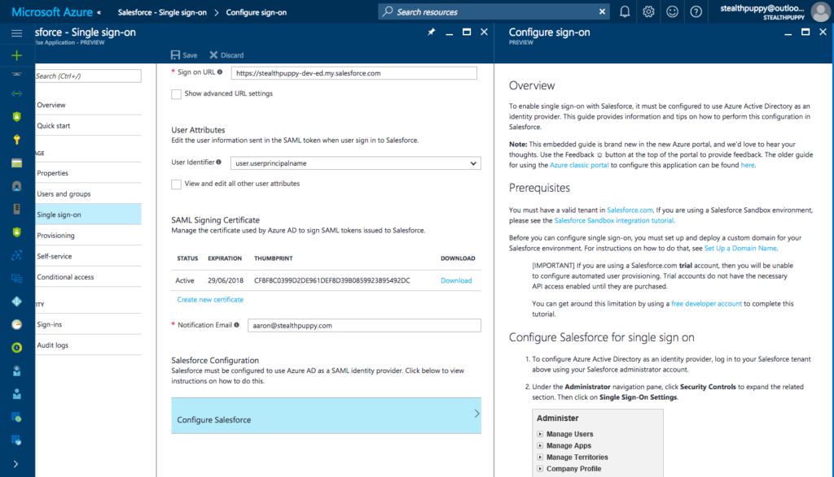
User SSO from External Application to Internal Application (e.g. SalesForce)
Future
Scenario
Microsoft Azure Active Directory
Register SalesForce as an Enterprise Application on Azure AD
Notes:
Notes:
Setting up SalesForce SSO - https://stealthpuppy.com/tips-enabling-sso-salesforce-azure-ad/#.WjuZlN-WZPY

